Slide 1


SOFTWARE ARCHITECTURE
ORIENTAL INSTITUTE OF SCIENCE AND TECHNOLOGY BHOPAL
[www.oriental.ac.in]
DEPARTMENT OF COMPUTER SCIENCE AND ENGINEERING
By
Harita Bhargava
Assistant Professor
CSE,OIST Bhopal

Slide 2
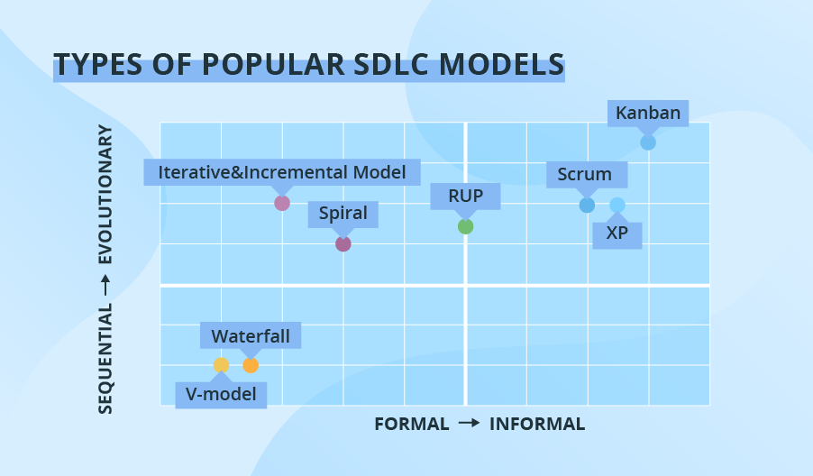
ORIENTAL INSTITUTE OF SCIENCE AND TECHNOLOGY BHOPAL
[www.oriental.ac.in]
Department of Computer Science and Engineering
Software Development Methodologies

Slide 3
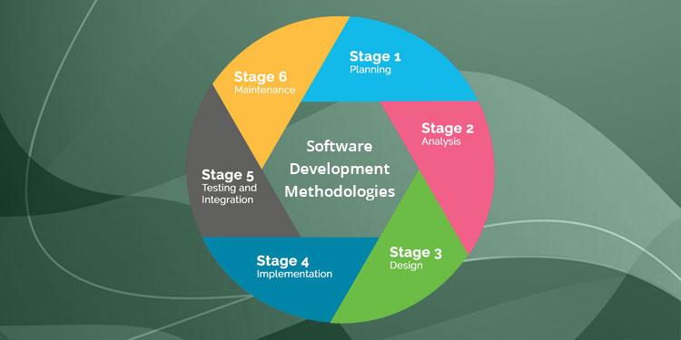
ORIENTAL INSTITUTE OF SCIENCE AND TECHNOLOGY BHOPAL
[www.oriental.ac.in]
Department of Computer Science and Engineering
Software Development Methodologies

Slide 4
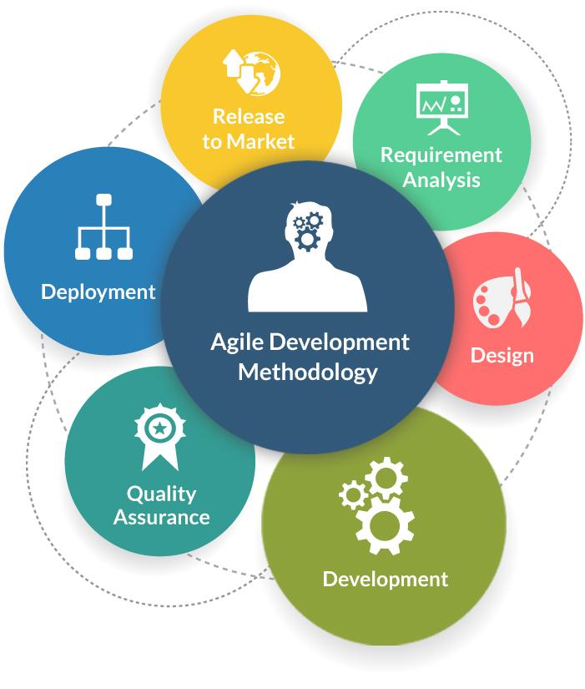
ORIENTAL INSTITUTE OF SCIENCE AND TECHNOLOGY BHOPAL
[www.oriental.ac.in]
Department of Computer Science and Engineering
Agile Development Methodologies

Slide 5
ORIENTAL INSTITUTE OF SCIENCE AND TECHNOLOGY BHOPAL
[www.oriental.ac.in]
Department of Computer Science and Engineering
Advantages of Agile Development Methodology
Customer satisfaction by rapid, continuous delivery of useful software.
People and interactions are emphasized rather than process and tools. Customers, developers and testers constantly interact with each other.
Agile methodology has an adaptive approach that is able to respond to the changing requirements of the clients.
Direct communication and constant feedback from customer representatives leave no space for any guesswork in the system.

Slide 6
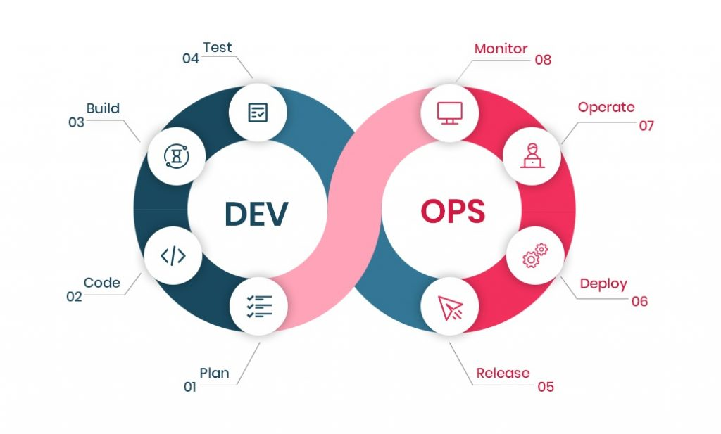
ORIENTAL INSTITUTE OF SCIENCE AND TECHNOLOGY BHOPAL
[www.oriental.ac.in]
Department of Computer Science and Engineering
DevOps Development Methodologies

Slide 7
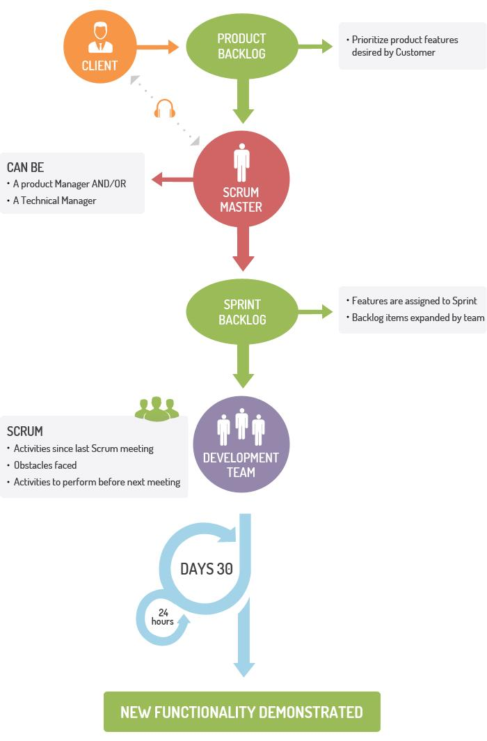
ORIENTAL INSTITUTE OF SCIENCE AND TECHNOLOGY BHOPAL
[www.oriental.ac.in]
Department of Computer Science and Engineering
Scrum Development Methodologies

Slide 8
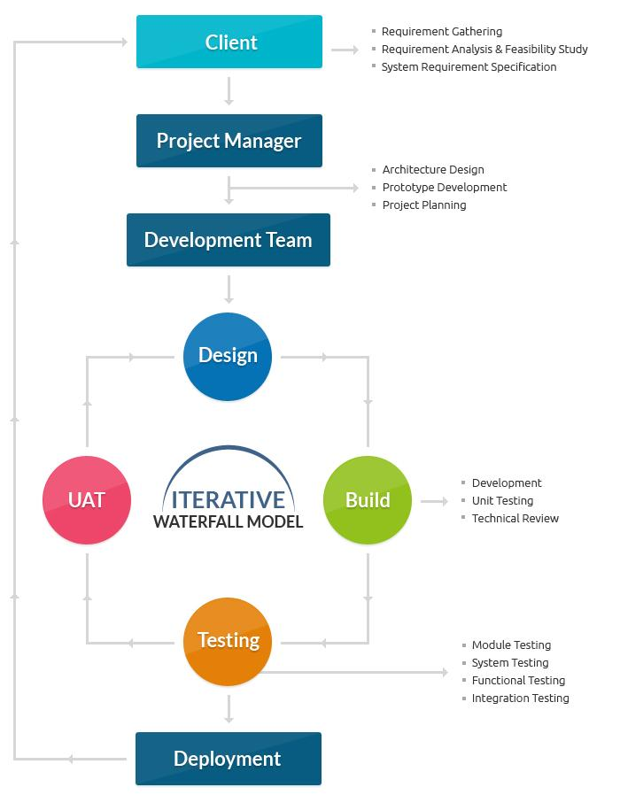
ORIENTAL INSTITUTE OF SCIENCE AND TECHNOLOGY BHOPAL
[www.oriental.ac.in]
Department of Computer Science and Engineering
Waterfall Model

Slide 9
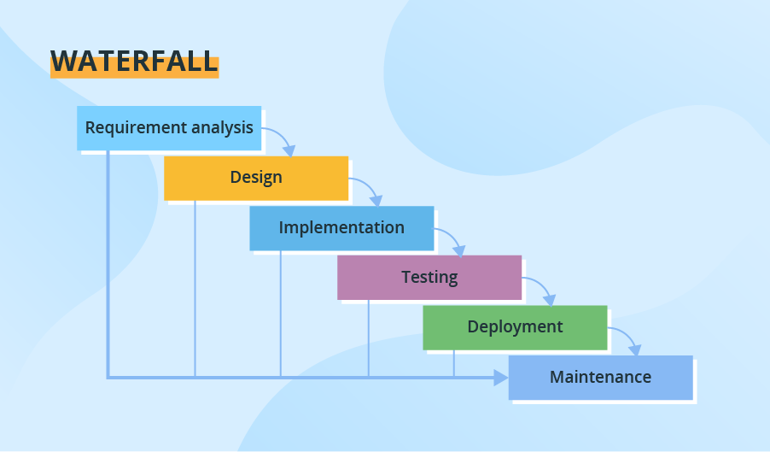
ORIENTAL INSTITUTE OF SCIENCE AND TECHNOLOGY BHOPAL
[www.oriental.ac.in]
Department of Computer Science and Engineering
Waterfall Model

Slide 10
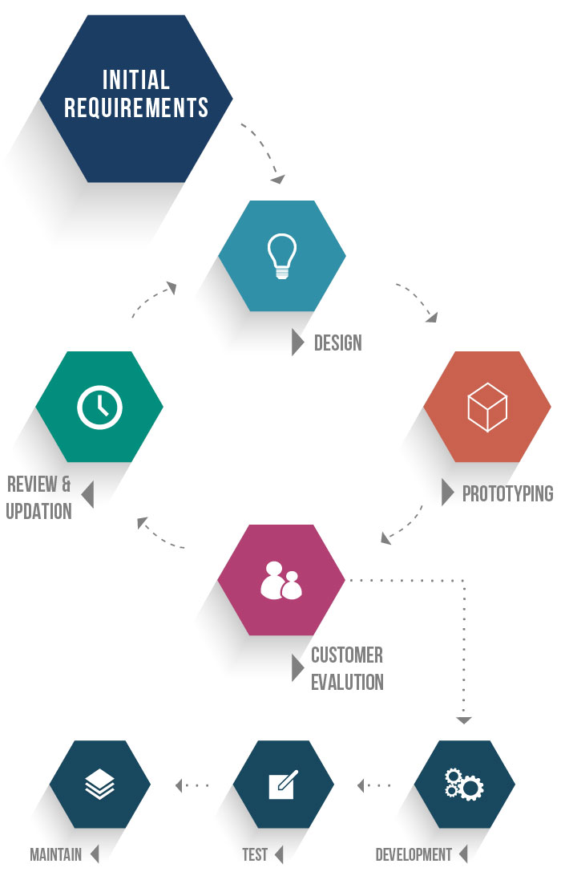
ORIENTAL INSTITUTE OF SCIENCE AND TECHNOLOGY BHOPAL
[www.oriental.ac.in]
Department of Computer Science and Engineering
Prototype Methodology

Slide 11
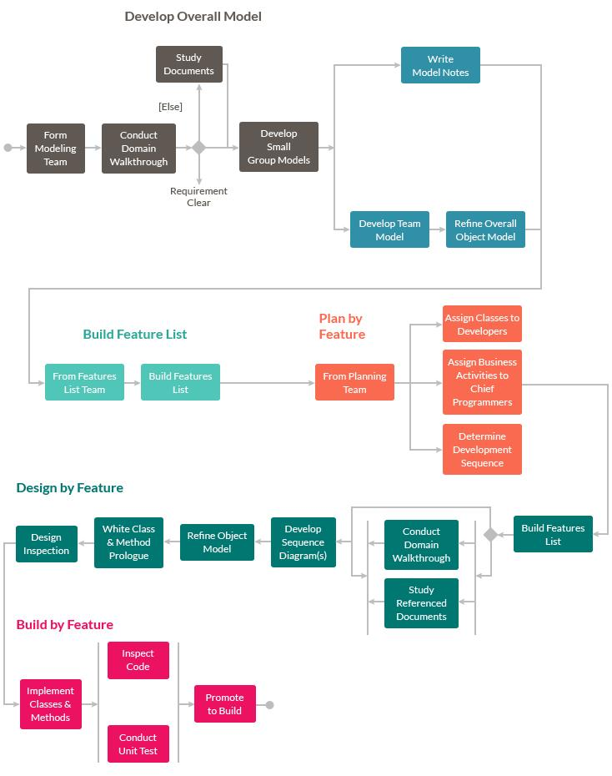
ORIENTAL INSTITUTE OF SCIENCE AND TECHNOLOGY BHOPAL
[www.oriental.ac.in]
Department of Computer Science and Engineering
Feature Driven Development

Slide 12
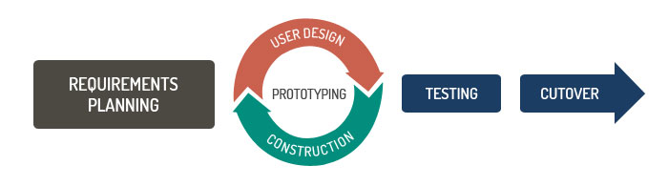
ORIENTAL INSTITUTE OF SCIENCE AND TECHNOLOGY BHOPAL
[www.oriental.ac.in]
Department of Computer Science and Engineering
Rapid Application Development (RAD)

Slide 13
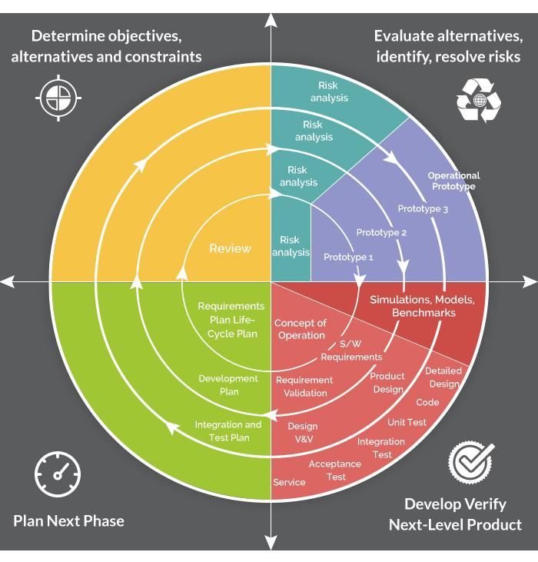
ORIENTAL INSTITUTE OF SCIENCE AND TECHNOLOGY BHOPAL
[www.oriental.ac.in]
Department of Computer Science and Engineering
Spiral Model

Slide 14
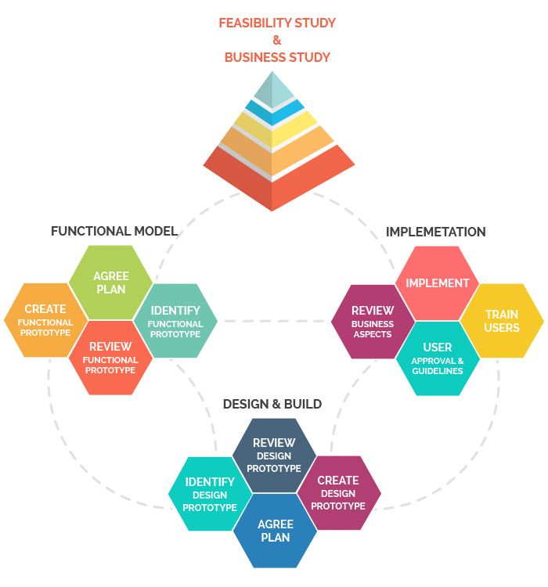
ORIENTAL INSTITUTE OF SCIENCE AND TECHNOLOGY BHOPAL
[www.oriental.ac.in]
Department of Computer Science and Engineering
Dynamic Systems Development Model Methodology

Slide 15
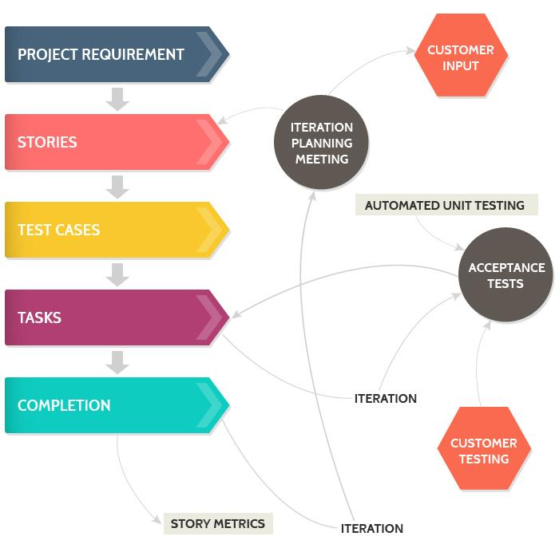
ORIENTAL INSTITUTE OF SCIENCE AND TECHNOLOGY BHOPAL
[www.oriental.ac.in]
Department of Computer Science and Engineering
Extreme Programming Methodology

Slide 16
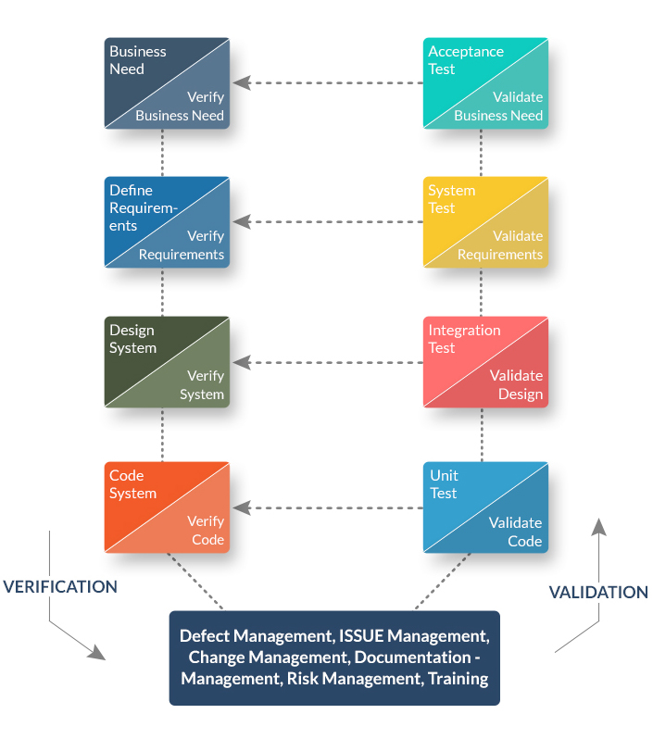
ORIENTAL INSTITUTE OF SCIENCE AND TECHNOLOGY BHOPAL
[www.oriental.ac.in]
Department of Computer Science and Engineering
Joint Application Development Methodology

Slide 17
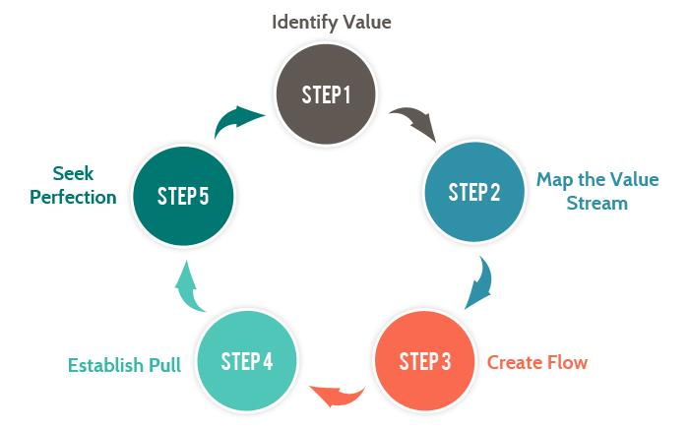
ORIENTAL INSTITUTE OF SCIENCE AND TECHNOLOGY BHOPAL
[www.oriental.ac.in]
Department of Computer Science and Engineering
Lean Development Methodology

